Slide 1
DATASET CS JOBS SALARY
LUCA DI BELLO - DATA SCIENCE - 2022/202

Slide 2
Summary
Salary analysis of IT jobs in the field of :
Artificial Intelligence
Cyber Security
DevOps
3 different datasets
One row = one employee's annual salary record
Analysis limited to the US

Slide 3
Interesting results

Slide 4
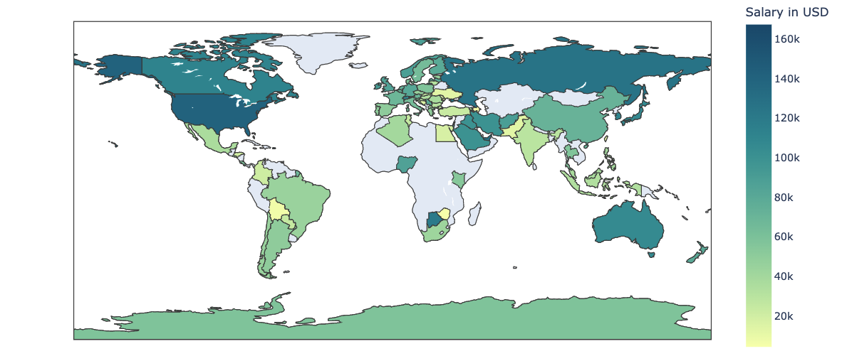
World data

Slide 5
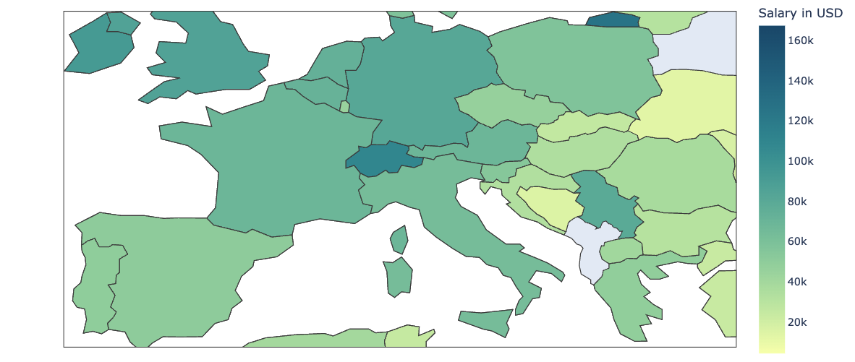
🇩🇪
🇫🇷
🇨🇭
🇦🇹
🇮🇹
🇪🇸
Center EU data
1° Switzerland

Slide 6
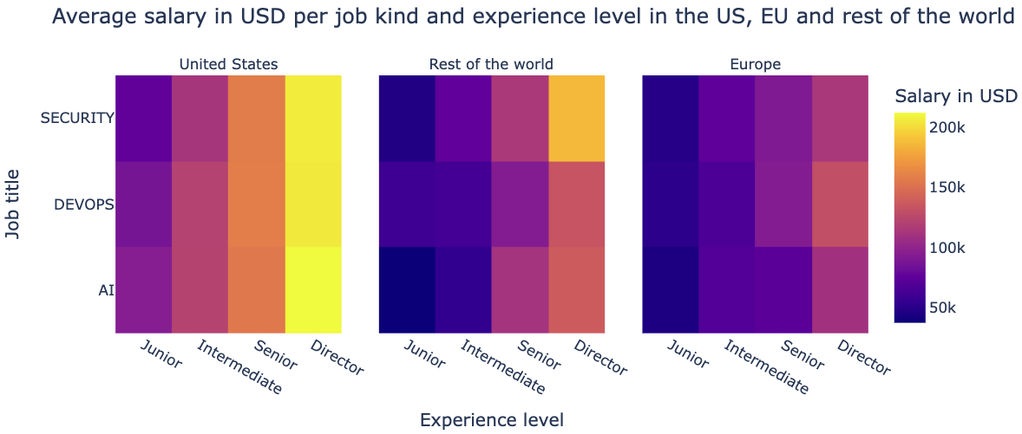
US earn more → EU less taxes

Slide 7
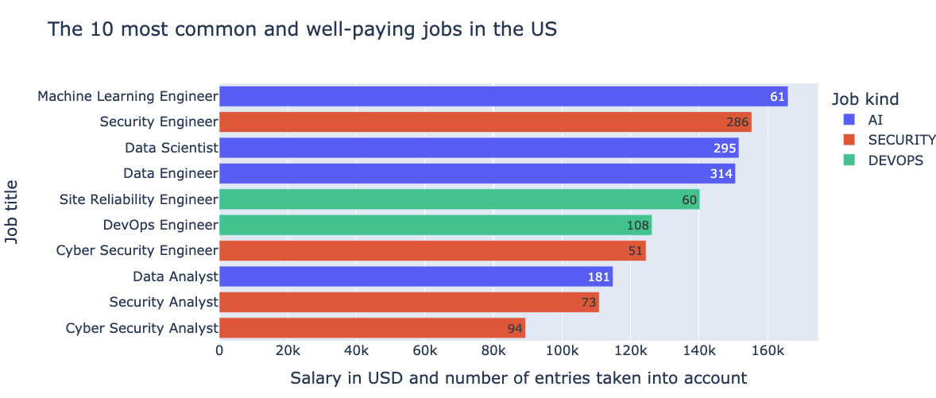

Slide 8
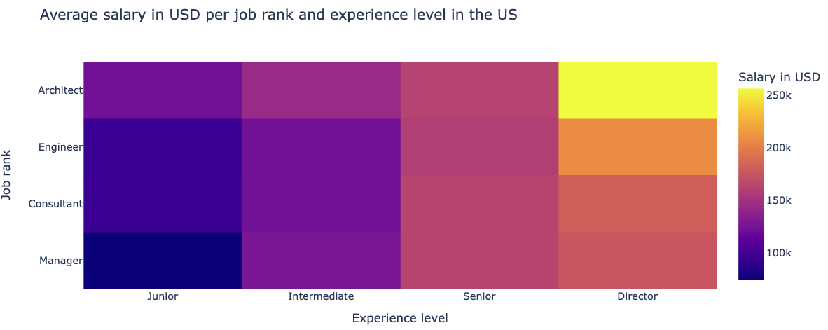
Architects = Most paid
Engineers ~= Consultants

Slide 9
